Slide 1
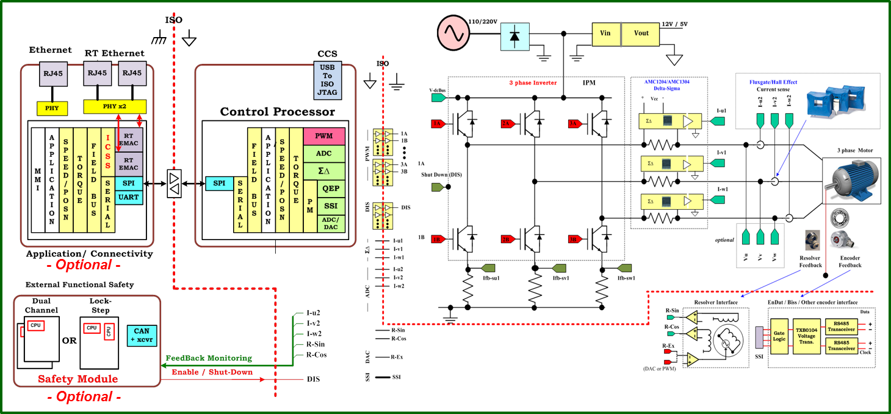

TMS320F2837xD
PMSM Servo

Slide 2
TMDXIDDK379D
TMS320F2837xD
PMSM Servo

